Slide 1
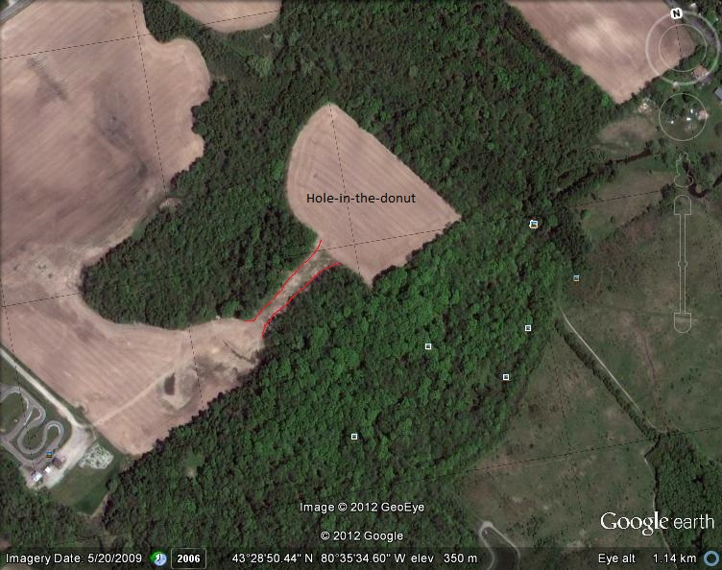

Slide 2
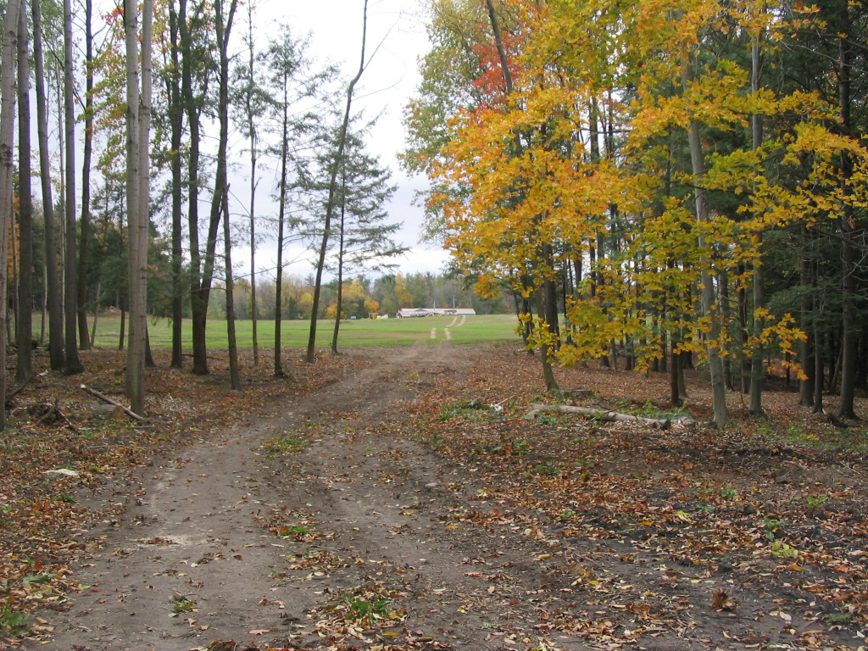

Slide 3
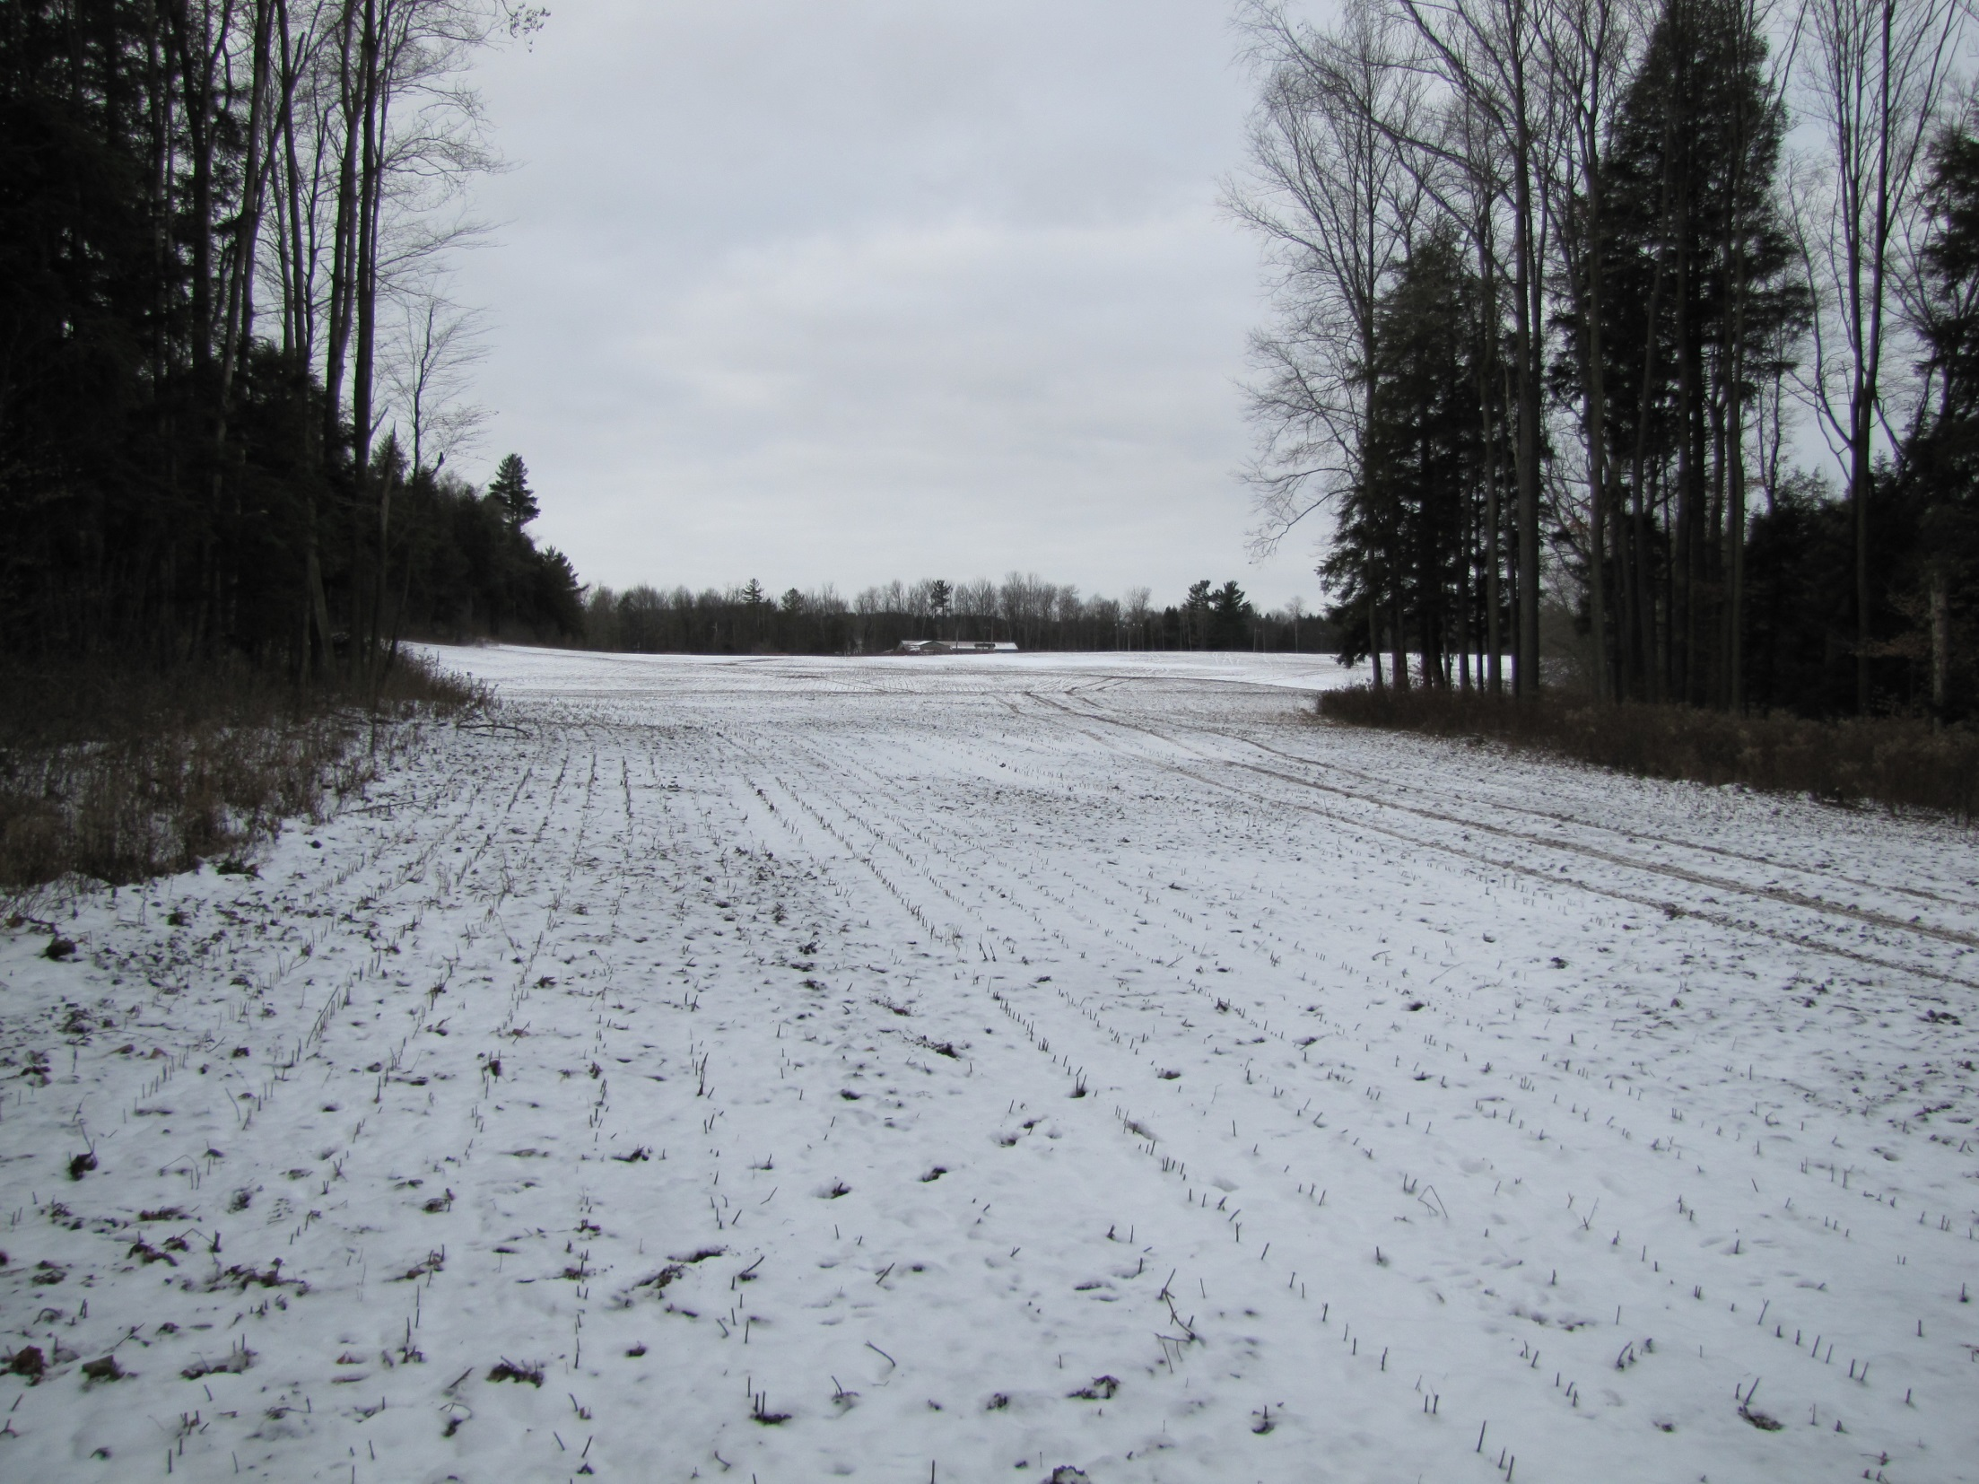

Slide 5
“…land use could include:
Residential uses, and/or
Open Space, and/or a
Restoration Area.”
Page 33, Beaver Creek Meadows District Plan

Slide 6
“We are all stewards of the environment. Acting now by preserving the natural environment, reducing our carbon footprint and building the city in an environmentally sound manner, will benefit future generations.”

